Slide 1
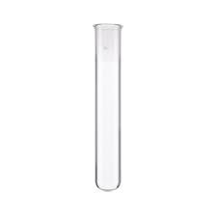
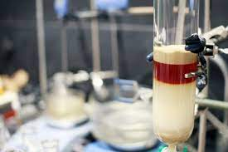
Senior Sophistor Year Capstone Research Project & Problems Assignment 2021-22

Slide 2
Structure of the year
 | Semester 1 | Semester 2
Activities | Capstone Research Project Problem-solving through self-directed learning. | Taught modules Problem-solving through self-directed learning and tutorials.
Assessments | Viva voce examination of: capstone project problem-solving of “seen” problems covering years 1-3 of moderatorship | Written examinations: 6 papers for C 5 papers for MC 5 papers for CMM 2 CH papers for NPCAM
Semester 1 will focus on self-directed learning (development of problem solving skills) and on research work towards completion of capstone project.
Activities in semester 1 will be assessed via viva voce examination during the TCD scheduled assessment week.
During semester 2 students will enrol in taught modules and will continue to develop problem-solving skills. Activities in semester 2 will be assessed via written examination (either online or in person) during the TCD scheduled assessment week.

Slide 3
Structure of the year
(May be subject to change)
Module | ECTS | Cohort |  |  |  | Viva |  | Paper
 |  | C | MC | CMM | N | % | Sem. | % | Sem. | time (h)**
CHU44120 | 20 | x |  |  |  | 100 | S1 | - | - | -
CHU44720 | 20 |  |  | x |  | 100 | S1 | - | - | -
CHU44420 | 20 |  | x |  |  | 100 | S1 | - | - | -
CHU44123 | 5 | x | x | x |  | 20 | S1 | 80 | S2 | 3
CHU44204 | 5 | x | x | x |  | - | - | 100 | S2 | 3
CHU44004 | 5 | x | x | x | x | - | - | 85 | S2 | 3
CHU44304 | 5 | x | x | x | x | - | - | 100 | S2 | 3
CHU44205 | 10 | x | x | x |  | - | - | 100 | S2 | 5
CHU44005 | 10 | x |  | x |  | - | - | 100 | S2 | 5
CHU44167 | 10 | x |  | x | x | - | - | 100 | S2 | 5
CHU44705 | 10 | x |  | x | x | - | - | 100 | S2 | 5
CHU44405 | 10 |  | x |  |  | - | - | 100 | S2 | 5
New module codes (check when looking for past exam papers!!)
Module | Title | Moderatorship
 |  | C | MC | CMM | N
CHU44120 | Capstone Project | x | x* | x** | x***
CHU44123 | Problems Module | x | x | x
CHU44004 | Inorganic Chemistry | x | x | x | x
CHU44204 | Organic Chemistry | x | x | x
CHU44304 | Physical Chemistry | x | x | x | x
CHU44005 | Advanced Inorganic Chemistry | x |  | x | x
CHU44205 | Advanced Organic Chemistry | x | x | x
CHU44167 | Advanced Physical Chemistry | x |  | x | x
CHU44705 | Advanced Computational Chemistry | x |  | x | x
CHU44405 | Advanced Medicinal Chemistry |  | x
{
CHU44720 (for CMM)
CHU44420 (for Med Chem)

Slide 4
COVID Impact
You should:
familiarize yourself with the Chemistry Return to Work Process Document 2021
download and keep a Personal Contacts Log (people you are in close contact with who are not members of your lab). This will make it easier for the HSE to track close contacts if you test positive for Covid.
follow any rules set out for the building in which you are working (in addition to those specified by your project supervisor or the School).
sign in and out of each Chemistry building you are in throughout the day using the relevant sign-in/out forms
Masks should be worn in all places where more than one person is present (e.g. labs and write-up rooms) unless all of those present are happy to disclose (through sharing of their Covid cert) that they are fully vaccinated.
The rules on social distancing are to be relaxed from reading week but, until then, attend the lab only when you have an experiment to perform or a meeting to attend (task-based rather than time-based attendance)

Slide 5
Semester 1 – Important Dates
Capstone Research Project (20 credits) & Problem-Solving Module
Start of the Project: September 13th
Duration: 12 weeks
Safety workshop 13th of September
Electronic Submission of solutions to 6 Problems: 16.30 on November 19th 2021
Electronic Submission of Report: 16.30 on December 3rd 2021
To create a fair evaluation method and to keep with college guidelines on plagiarism it has been decided to make use of the software embedded into blackboard during electronic report submission.
Electronic Submissions only!
Examination: The week of 13th-17th of December 2021

Slide 6
Capstone Research Project – Structure of the Report
Discuss the structure and content of the report with your supervisor.
The report must be typed with font size 12, double line spaced, bound and not longer than 30 pages in length.
Your laboratory notebooks together with appendices of spectra etc. if appropriate must also be handed in at this time.
It is crucial that you allow sufficient time for the completion of your report. NB. Your supervisor must receive a draft copy of your report allowing sufficient time for feedback/corrections.
Discuss the writing with him/her! Know what is expected of you…..

Slide 7
You must add a ‘Covid Statement’ of 200 words or less at the start of their thesis.
You will need to outline any factors associated with Covid that may have negatively impacted your ability to carry out their SS project.
This could include not being able to access your lab full time due to capacity issues.
This statement must be signed by your supervisor before submitting your thesis and will be taken into consideration by your examiners.

Slide 8
Project - Safety
Standard safety regulations also apply to research laboratories: Lab-coats and safety glasses must be worn; eating and drinking is not allowed in the laboratories.
Extra regulations in place for COVID-19
Access to research labs will be revoked immediately if you are found to be in breach of safety guidelines!
Project students should get a safety tour by supervisors; familiarise yourself with the locations of fire extinguishers, fire blankets, safety exits, showers
Plan your experiments well in advance; familiarise yourself with risks associated with starting materials, products (SDS), instruments etc.
Consult with supervisors/advisors to discuss safety aspects before starting the experiments
Overnight experiments need to be signed off by your supervisor.
College Emergency Number: Ext. 1999

Slide 9
Capstone Research Project – Structure of the Report
1. Introduction and Objectives of the Project: Identifies the scientific aims of the project and set this in context with other current and recent work
2. Results and Discussion: The experiments conducted, and results are set out and described. Results should be discussed and set in context with the recent literature so that their significance is evident. A clear story should be developed so that the reader is lead through the project, understanding why experiments were performed and the relevance of the results at each stage. The R&D section should lead on from the introduction, and into the conclusion, building on ideas from the introduction and clearly highlighting key results for the conclusion.
3. Experimental Sections/Materials and Methods: Experimental work should be described so that the experiments and results can be reproduced by other researchers. Appropriate characterisations and analyses need to be provided in order to provide evidence for the claims in the R&D section.
3. Conclusions and Future Work: The conclusions should be fully supported by the results. The conclusions should be discussed and set in the context of current and recent literature. The conclusions should be used to suggest a series of experiments highly likely to lead to further useful results which extend the current study into new and important areas.
5. References: related work and underlying concepts should be referenced; the references should obey the format of a recognised scientific journal (format of Angewandte Chemie, J. Am. Chem. Soc., (ACS) Chem. Commun. (RSC)...

Slide 10
3. Experimental Sections/Materials and Methods:
This section is written in the 3rd person past passive voice and is a concise summary of what you did.
It should contain the actual procedure you carried out in the course of the experiment
It should include any modifications you had to make to the methods or reagents adopted elsewhere, s well as your observations, for example the solutions colours, the evolution of heat or gas, etc. It is never written as a series of numbered points. Reread your experimental think if you could repeat the experiment.
For more examples of this style look in any chemistry journal

Slide 11
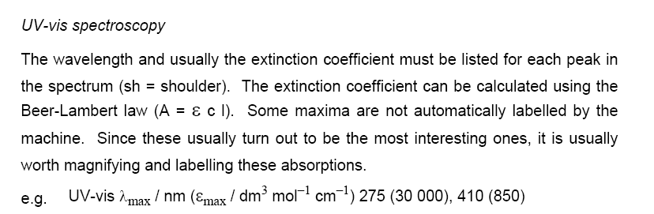

Slide 12
NMR Spectroscopy:
It is important to include:
the nucleus (e.g. ¹H, ¹³C, ³¹P). Remember ¹³C and ¹³C{¹H} are not the same and you measure ¹³C{¹H} routinely
the frequency of the spectrometer (e.g. 250 MHz, 400 MHz)
the solvent (CDCl₃, D₂O)
the identity of the signal if it is known.
The order of the signals is from high to low field, (ie. from large to small ppm).
For proton spectra, the number of protons (the signal integration), the peak multiplicity, the coupling constant J in Hertz are also included.
Peak multiplicities are described as s = singlet, d = doublet, t = triplet, dd = doublet of doublets, dt = doublet of triplets, m = multiplet.
Remember that for proton signals the coupling constant is the interval between peaks multiplied by the frequency of the field in MHz.

Slide 13
3. Experimental Sections/Materials and Methods (in/organic):
N-[1-Methyl-pyprazino-ethyl]-4-nitro-1,8-naphthalimide, (8)
Compound 8 was synthesised by reacting 1-(2-aminoethyl)-4-methylpiperazine (2.47 g, 2.58 mL, 17.2 mmol, 1.4 eq.) with 4-nitro-1,8-naphthalic anhydride (3.0 g, 12.3 mmol, 1 eq.) and Et₃N (2.5 g, 3.56 mL, 24.6 mmol, 2 eq.) in anhydrous toluene (200 ml), to yield the product as a brown solid (3.50 g, 77%) after a recrystallisation from MeOH. m.p. 109 - 111 ºC; HRMS: 369.1554 ([M + H]⁺. C₁₉H₂₁N₄O₄ requires 369.1563); δ_{H} (400 MHz, CDCl₃), 8.85 (1H, d, J = 9.0 Hz, Ar-H7), 8.74 (1H, d, J = 7.5 Hz, Ar-H5), 8.70 (1H, d, J = 8.0 Hz, Ar-H2), 8.42 (1H, d, J = 8.0 Hz, Ar-H3), 8.00 (1H, t, J = 8.0 Hz, Ar-H6), 4.36 (2H, t, J = 7.0 Hz, NCH₂CH₂N(CH₂CH₂)₂NCH₃), 2.73 (2H, t, J = 7.0 Hz, NCH₂CH₂N(CH₂CH₂)₂NCH₃), 2.65(4H, s, NCH₂CH₂N(CH₂CH₂)₂NCH₃), 2.44 (4H, br. s, NCH₂CH₂N(CH₂CH₂)₂NCH₃), 2.28 (3H, s, NCH₂CH₂N(CH₂CH₂)₂NCH₃); δc (100 MHz, CDCl₃), 162.7, 161.9, 149.0, 131.8, 129.4, 129.2, 128.7, 128.5, 126.4,123.4, 123.1, 122.4, 54.9, 54.6, 52.7, 45.5, 45.5, 37.3; m/z: 369 (M + H)⁺; ν_{max} (neat sample)/cm⁻¹ 3078, 2928, 2793, 2757, 1655, 1522,1339, 824, 761.

Slide 14
Hint and tips (a.k.a the voice of experience)
In the lab:
There is no such thing as a stupid question. Don’t be afraid to ask for help.
Be organised, meticulous and tidy.
You have your spectroscopic data but look at it now not when you write up. Is it correct? Do you need to remove the last traces of toluene to get a nice spectrum? A printed spectrum is not an assigned spectrum so get the integrations, chemical shifts and assignments done straight away.
Don’t be afraid to ask for help
Literature searching:
Use some of the search engines and not just Wikipedia
Referencing your R&D section is easier as you go along
Care is needed when using citation managers (endnote) as it does not just work
Writing up:
Everything takes π times longer than you expect; don’t leave it until the last minute
Pay attention to your experimental section.
The intro, R&D and conclusions should tell a story; hold the reader’s hand through your story!

Slide 15
Literature Searching

Slide 16
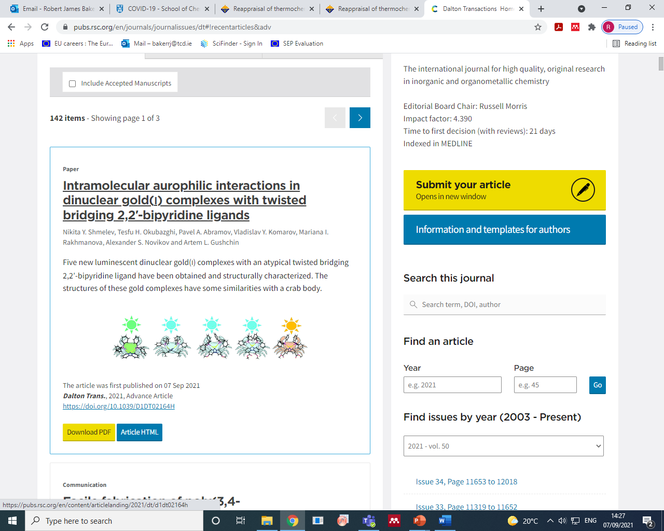
Literature Searching
Online access at home:
take https://pubs.rsc.org/en/content/articlelanding/2021/dt/d1dt02164h
And modify the address to:
http://pubs.rsc.org.elib.tcd.ie/en/content/articlelanding/2021/dt/d1dt02164h

Slide 17
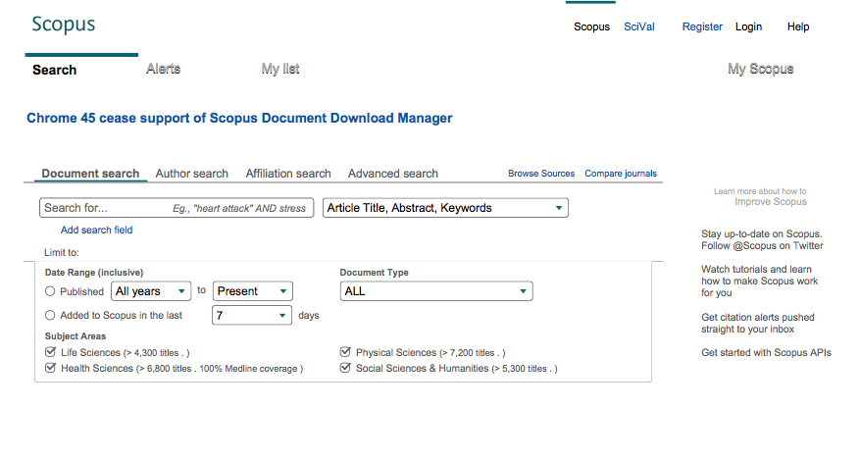
Literature Searching

Slide 18
Literature Searching

Slide 19
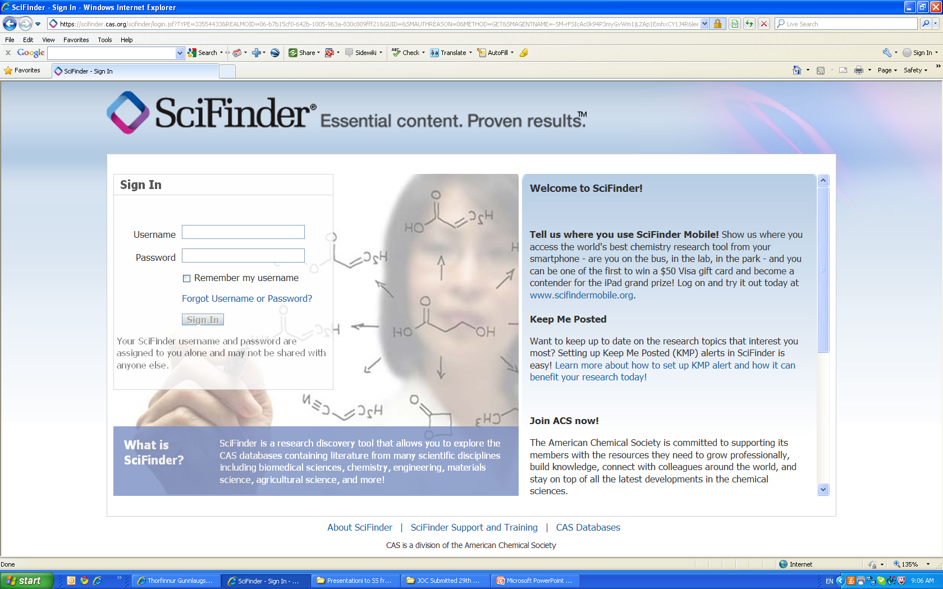
Literature Searching

Slide 20
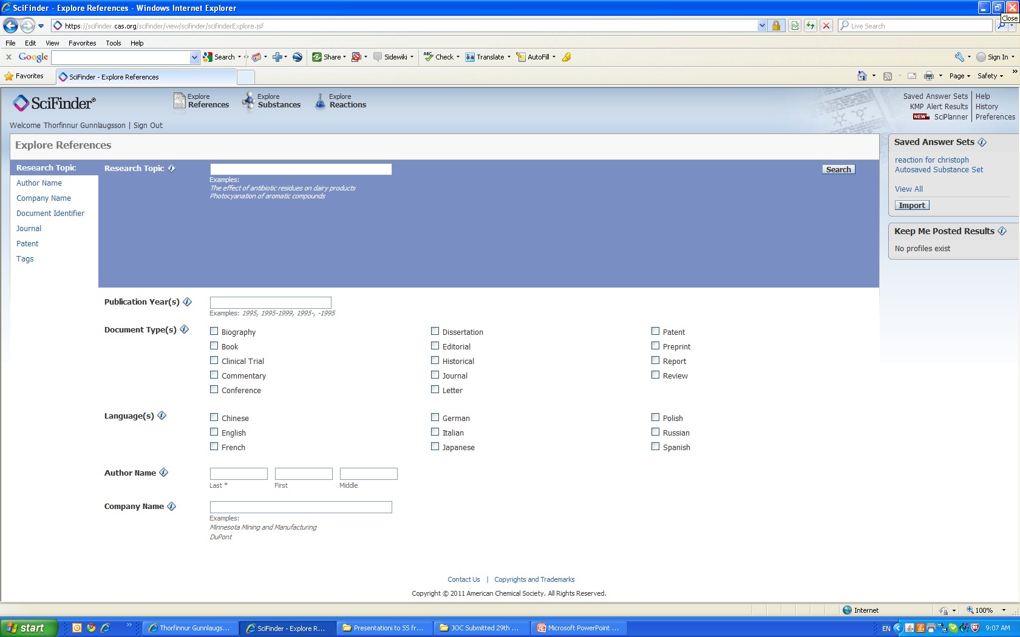
Literature Searching

Slide 21
Capstone Research Project – Assessment
Project Assessment: Your project work will be assessed by:
three examiners:
Supervisor (20%): will submit a written report on the work conducted.
Two other assessors (40% ea.): will mark the project report and conduct a formal assessment involving a 10 min. presentation by the student followed by a 20min question & answer session in which the work and underlying theoretical concepts will be discussed. The problems will then be discussed.
Dates for presentations: Semester 1 (13th-17th December). These will be online
Marks for your project will be allotted on the basis of quality of content, presentation, effort made, and performance during the oral examination….

Slide 22
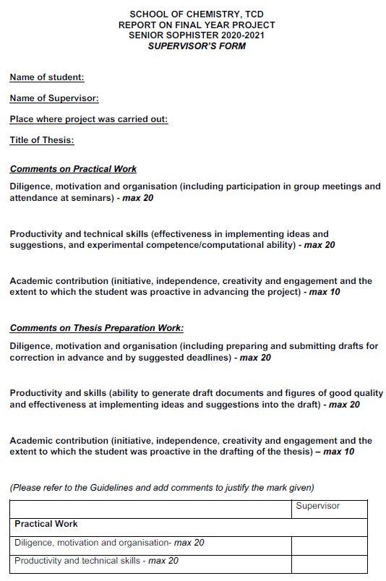
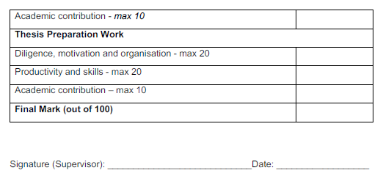

Slide 23
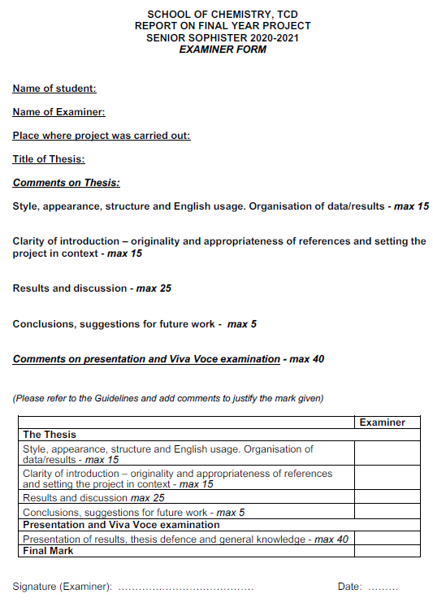

Slide 24
Problem Solving – Assignment
Module codes: CHU44123
Credit bearing: 10 ECTS (15% assessed in S1 viva assessment, 85% assessed in examination paper in S2)
In semester 1, you will be given one assignment with a total of 6 problems covering years 1-3 of your moderatorship.
You will solve the problems in an independent manner; if you find errors in the questions then discuss this in your answer!
You are encouraged to consult textbooks and scientific literature to work on your solutions but are not allowed to copy solutions from fellow students.
After submission of your solutions you are free to discuss the problems with others in your SS class.
You must submit your solutions to all six problems via blackboard after study week, by Friday November 19th.

Slide 25
Problem Solving – Viva Voce Assessment
Viva voce examination for problem solving component will take place on the same day of your Research Project viva voce examination.
This section of the viva will be 10 min long and will take place after the discussion of the project is closed.
The assessors will select one of the 6 problems in the assignment and will ask the student to solve either the problem or a section of it during the examination (pen and paper or blackboard), and discuss/articulate the approach taken.
You might be asked to identify, discuss and/or correct any mistakes made in the submission.

Slide 26
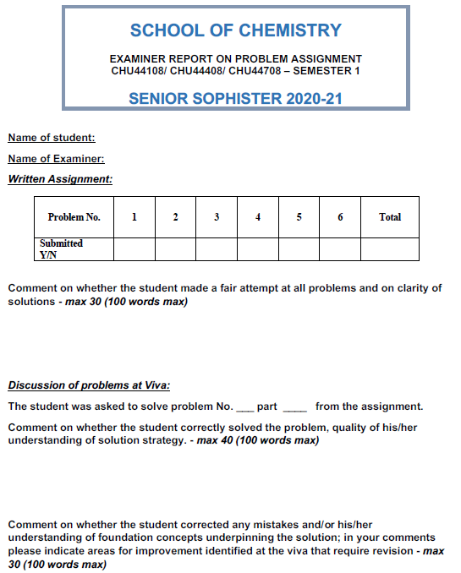

Slide 27
Moderatorship Examinations
The Final degree mark: 30% from JS Mark and 70% from the SS year.
Project mark + Problem Solving Mark in Semester 1 : 21.5 credits ≈ 35.83%
Examinations in Semester 2: 38.5 credits ≈ 64.17%
External examiners:
External examiners (for Chem, MedChems and CMMs) will visit for two days after semester 2 examinations (either in person or virtual). Dates to be confirmed
As a result of new calendar regulations, students will have the right to reassessment in their final year on all modules except the capstone project. Students who do not pass the sophister examinations will be able to repeat the year.

Slide 28
Summary of important dates
 | TCD Project | Project Abroad
Start | 13th September | September
End Project work | 26th November | 26th November
Hand in Project Report | 3rd December | 3rd December
Supervisors Mark | Supervisor 20% | External Supervisor 20%
Presentation | 13th-17th December | 13th-17th December
Presentations / review | Examiners 80% | Examiners 80%

Slide 29
Key dates
Call open | 16:00 (Irish time) 2 September 2021
FAQ deadline | 16:00 (Irish time) 14 October 2021
Applicant deadline | 16:00 (Irish time) 21 October 2021
Supervisor and referee deadline | 16:00 (Irish time) 4 November 2021
Research office endorsement deadline | 16:00 (Irish time) 18 November 2021
Call outcome | End of March 2022
Award start date | 1 September 2022
http://research.ie/funding/goipg/

Slide 30
Contacts:
Prof. Bob Baker Prof. Peter Dunne
SS Year Coordinator NPCAM Director
bakerrj@tcd.ie dunnep13@tcd.ie
Prof. Yurii Gunko Prof. Valeria Nicolosi
Director of Teaching & Learning (UG) Associate Director of Teaching & Learning (UG)
IGOUNKO@tcd.ie nicolov@tcd.ie
Prof. Aidan McDonald Prof. Stephen Connon
Head of Discipline Head of Discipline
Inorganic & Synthetic Materials Organic, Medicinal & Biological Chemistry
aidan.mcdonald@tcd.ie connons@tcd.ie
Prof. Mathias Senge Prof. Paula Colavita
Director of Medicinal Chemistry Head of Discipline
msengem@tcd.ie Physical, Computational & Materials Chemistry colavitp@tcd.ie
For help with Mental Health problems use your tutor, student counselling, your GP….

